Slide 1

Career Development Analysis

Slide 2
Objective
The objective of this task is to analyze key metrics related to career development, identify areas for improvement, and propose actionable strategies to support employee advancement within the organization.

Slide 3
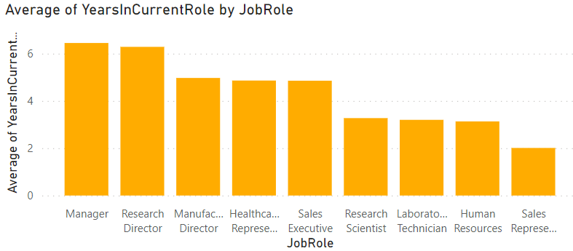
Average Years in Current Role
The average tenure is fairly consistent across departments.
Manager and Research Director employees tend to stay in their roles slightly longer, while Sales Representative employees have the shortest time in their current roles.

Slide 4
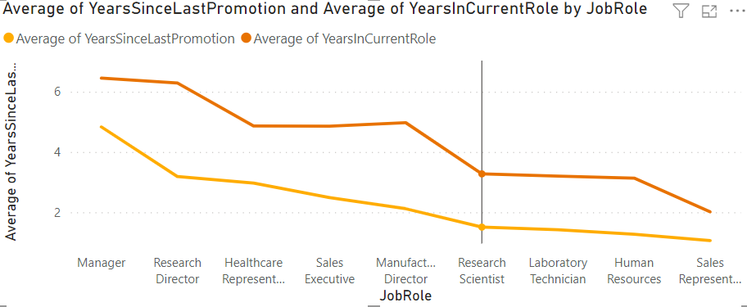

Average Years Since Last Promotion:
Following employees have the longest duration since their last promotion, suggesting potential stagnation in career progression within this department.
Research Director
Manufacturing Director
Health Representative
Sales Executive

Slide 5
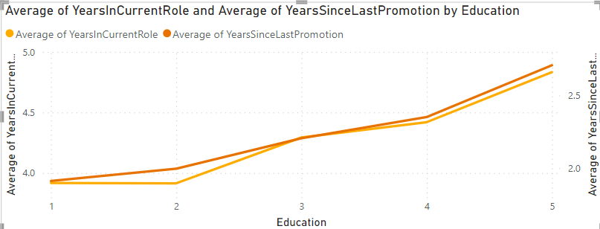
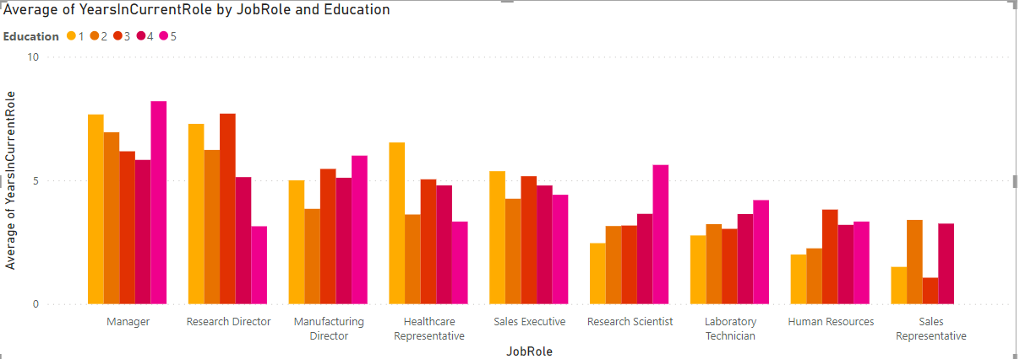
Distribution of Education Levels
Employees with Doctorates tend to stay with the company longer, both in their job roles and without promotion.
The more educated employees have longer periods since their last promotion, potentially indicating either a ceiling effect in promotions or fewer promotion opportunities.

Slide 6
Areas of Improvement
Employees with Master's or Doctorate degrees are spending more time in their current roles without promotions. This could indicate a lack of upward mobility for these groups, which may impact retention.
The Research Director and department, in particular, has employees who have gone longer without promotions compared to other departments, despite similar tenures at the company.

Slide 7
Proposed Strategies for Advancement
Enhanced Career Development Programs: Implement specialized training and mentorship programs targeting employees with advanced degrees to facilitate their progression into leadership roles.
Review Promotion Criteria: Assess the current promotion criteria and processes to ensure they are inclusive and provide fair opportunities for advancement across all education levels.
Department-Specific Strategies: Focus on the Sales department to create more structured career paths and clear promotion opportunities to prevent stagnation.

Slide 8
Thank You

